Slide 1
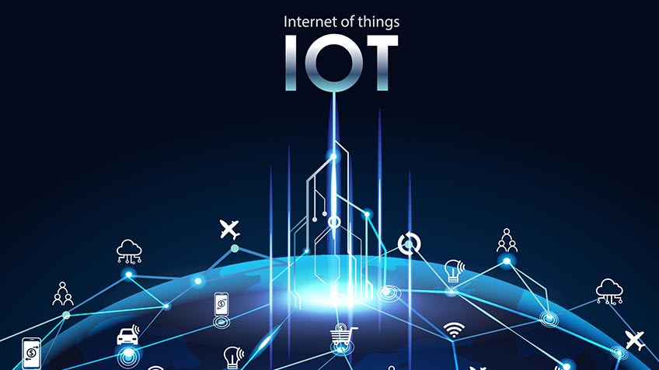



Slide 2
Table Of Content
IoT Definition
How IoT helps(benefits)?
What is an example of an Internet of Things device?
IoT benefits to organizations
IoT Applications
Physical Design
Logical Design

Slide 3
IoT Definition
“The Internet of Things (IoT) is a system of interrelated computing devices, mechanical and digital machines, objects, animals or people that are provided with unique identifiers and the ability to transfer data over a network without requiring human-to-human or human-to-computer interaction.”
The Internet of Things (IoT) describes the network of physical objects—“things”—that are embedded with sensors, software, and other technologies for the purpose of connecting and exchanging data with other devices and systems over the internet. These devices range from ordinary household objects to sophisticated industrial tools. With more than 7 billion connected IoT devices today, experts are expecting this number to grow to 10 billion by 2020 and 22 billion by 2025. Oracle has a network of device partners.

Slide 4
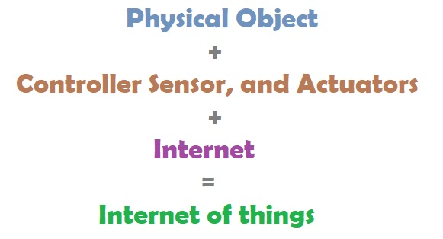
IoT Equation

Slide 5
How can Internet of things help?
Benefits of IoT
IoT platforms can help organizations reduce cost
through improved processes that minimizes the downtime and decreases the cost. e.g IoT powered industrial robots improves production output.
IoT boosts productivity and profitability:
– helps create optimized workflows through automation which minimizes repetitive tasks and facilitates optimal utilization of available resources and machinery.
– This optimization avoids wasted man hours in the organization.

Slide 6
How can Internet of things help?
Benefits of IoT
IoT platforms unearths the new business opportunities
– With improved tracking of devices/objects using sensors and
connectivity, organizations can benefit from real-time insights and
analytics, which would help them make smarter decisions.
– Businesses build new product lines and revenue models based on
emerging patterns.
e.g Insurers calculate the premium based on the driving habits.
Retailers plan their inventory levels and in-store display by recording
their consumer behaviour.
Marketers use IoT based Beacon technology to gather insights about
consumers.

Slide 7
How can Internet of things help?
Benefits of IoT
IoT promotes optimal asset utilization and tracking
– IoT can connect every unit, device, asset, machinery, or equipment to a single network.
– With smart sensors, businesses can then track assets and control equipment.
– Real-time insights and autonomous control reduces waste and optimizes the entire workflow.
– Asset-heavy industries like transportation use IoT to promote transparency through location tracking and updates.

Slide 8
How can Internet of things help?
Benefits of IoT
IoT improves security levels and minimizes vulnerabilities
– IoT reduces security risks and vulnerabilities through sensors designed for live surveillance in physical locations.
e.g connecting CCTV cameras to IoT networks creates a powerful surveillance network.

Slide 9
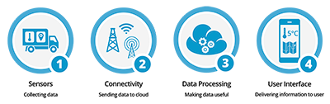
How IoT works?
1) Sensors/Devices
2) Connectivity
3) Data Processing
4)User Interface

Slide 10
1) Sensors/Devices
Sensors or devices are a key component that helps you to collect live data from the surrounding environment.
All this data may have various levels of complexities.
It could be a simple temperature monitoring sensor, or it may be in the form of the video feed.

Slide 11
2) Connectivity
All the collected data is sent to a cloud infrastructure.
The sensors should be connected to the cloud using various mediums of communications.
These communication mediums include mobile or satellite networks, Bluetooth, WI-FI, WAN, etc.

Slide 12
3) Data Processing
Once that data is collected, and it gets to the cloud, the software performs processing on the gathered data.
This process can be just checking the temperature reading on devices like AC or heaters.
However, it can sometimes also be very complex like identifying objects, using computer vision on video.

Slide 13
4)User Interface
The information needs to be available to the end-user in some way which can be achieved by triggering alarms on their phones or sending them notification through email or text message.
The user sometimes might need an interface which actively checks their IoT system.
For example, the user has a camera installed in his home. He wants to access video recording and all the feeds with the help of a web server.

Slide 14
What is an example of an Internet of Things device?
A light bulb that can be switched on using a smartphone app
An IoT device could be fluffy or serious.
Some larger objects may themselves be filled with many smaller IoT components
– e.g. smart cities projects are filling entire regions with sensors to help us understand and control the environment.

Slide 15
IoT Characteristics
1. Dynamic and Self-Adapting
IoT devices dynamically adapt themselves to changing contexts and scenarios.
e.g A surveillance camera should be adaptable to work in different light situations (morning, afternoon, and night).
2. Self Configuring
IoT devices are able to upgrade their software as per the requirements with a minimum of user participation.
Additionally, they can set up the network, allowing for the addition of new devices to an already-existing network.

Slide 16
IoT Characteristics
3. Interoperability
It refers to the ability of different IoT devices and systems to communicate and exchange data with each other, regardless of the underlying technology or manufacturer.
Interoperability is critical for the success of IoT—-seamless user experience
Without interoperability, IoT systems would be limited to individual silos of data and devices, making it difficult to share information and create new services and applications.
To achieve interoperability, IoT devices, and systems use standardized communication protocols and data formats.

Slide 17
Examples of standards used in IoT
MQTT (Message Queuing Telemetry Transport): is a publish/subscribe communication protocol used for IoT device communication.
CoAP (Constrained Application Protocol): CoAP (Constrained Application Protocol) is a lightweight communication protocol for IoT devices with limited resources.
Bluetooth Low Energy (BLE): is a wireless communication technology used for IoT devices with low power consumption requirements.
Wi-Fi: A wireless communication technology used for IoT devices that require high data transfer rates.
Zigbee: A low-power, low-cost wireless communication technology used for IoT devices.
In addition to communication protocols, IoT systems may also use data formats such as JSON or XML

Slide 18
IoT Characteristics
4. Intelligence and Identity
The extraction of knowledge from the generated data is very important.
Each IoT device has a unique identity. This identification is helpful in tracking the equipment and at times for querying its status.

Slide 19
IoT Characteristics
5. Autonomous operation (ability of IoT devices and systems to operate independently and make decisions without human intervention.)
IoT devices are designed to operate autonomously, without direct human intervention, making it possible to automate a wide range of processes and tasks.
The autonomous operation allows IoT systems to deliver new and innovative services and applications that can improve efficiency, reduce costs, and enhance the user experience.
In IoT systems, devices and systems are equipped with sensors, actuators, and processing power, allowing them to collect and process data about the environment, make decisions based on that data, and take action accordingly.
Autonomous operation is made possible by advances in artificial intelligence, machine learning, and cloud computing, which enable IoT devices and systems to process and analyze large amounts of data in real time and make decisions based on that data.

Slide 20
IoT Characteristics
6. Data-driven
The data collected by sensors is used to gain insights into the environment, improve operational efficiency, and make informed decisions.
Example:1) Monitor temperature and humidity levels in a building and optimize the ventilation, cooling and heating systems.----Energy saving and improved indoor air quality
2) Predictive maintenance:reduces the risk of unplanned downtime.
Data-driven IoT is made possible by advances in big data technologies, such as distributed data processing and cloud computing, which allow for the efficient analysis and management of large amounts of data in real time.

Slide 21
7. Context Awareness(understand and respond to the environment and context in which they are operating)
Context awareness is a critical aspect of IoT, as it enables IoT devices and systems to make decisions and take actions based on the context in which they are operating.
For example, in a smart home, a context-aware IoT system could adjust the temperature, lighting, and other systems based on the time of day, the presence of people in the home, and other factors.
In addition, context awareness is also used to improve the efficiency and effectiveness of IoT systems by reducing the amount of data that needs to be transmitted and processed.

Slide 22
IoT Characteristics
8. Scalability
The number of elements connected to the IoT zone is increasing day by day. Hence, an IoT setup should be capable of handling the massive expansion. The data generated as an outcome is enormous, and it should be handled appropriately.
9.Architecture
IoT Architecture cannot be homogeneous in nature. It should be hybrid, supporting different manufacturers ‘ products to function in the IoT network. IoT is not owned by anyone engineering branch. IoT is a reality when multiple domains come together.

Slide 23
IoT Characteristics
10. Safety
There is a danger of the sensitive personal details of the users getting compromised when all his/her devices are connected to the internet. This can cause a loss to the user. Hence, data security is the major challenge. Besides, the equipment involved is huge. IoT networks may also be at risk. Therefore, equipment safety is also critical.

Slide 24
IoT Characteristics
11. Ubiquity
Ubiquity refers to the widespread and pervasive presence of the Internet of Things (IoT) devices and systems in our daily lives. The goal of IoT is to create a seamless and interconnected world where devices and systems can communicate and share data seamlessly and transparently.
Ubiquity is achieved through the widespread deployment of IoT devices, such as sensors, actuators, and other connected devices, as well as the development of IoT networks and infrastructure to support communication and data exchange.
In a ubiquitous IoT environment, devices and systems can be accessed and controlled from anywhere, at any time, using a variety of devices, such as smartphones, laptops, and other connected devices.
For example, in a smart home, a person could use their smartphone to control the temperature, lighting, and other systems in their home, even when they are away.
In addition, ubiquity is also achieved through the integration of IoT with other technologies, such as artificial intelligence, big data, and cloud computing, which allow for the creation of more advanced and sophisticated IoT systems and applications.
Overall, ubiquity is a key characteristic of the IoT, and it is essential for realizing the full potential of IoT and creating a truly interconnected and smart world. IoT devices are widely distributed and can be found in a variety of environments, from homes and workplaces to public spaces and industrial settings.

Slide 25
Examples of IoT Devices
Home appliances: smart TV, smart refrigerator, smart AC, etc.
Smart phones and computers
Wearables: smart watch, smart sensors, etc.
Automobiles like self-driving cars
Energy systems
Retail : smart payment
Printers
Industrial machines
Healthcare: smart watch, smart healthcare, etc.
Surveillance: smart cameras, smart trackers, etc.

Slide 26
Physical Design of IoT
(Things + Protocols)
Things are Node devices which have unique identities and can perform remote sensing, actuating and monitoring capabilities.
IoT Protocols helps in Communication established between things and cloud based server over the Internet.

Slide 27
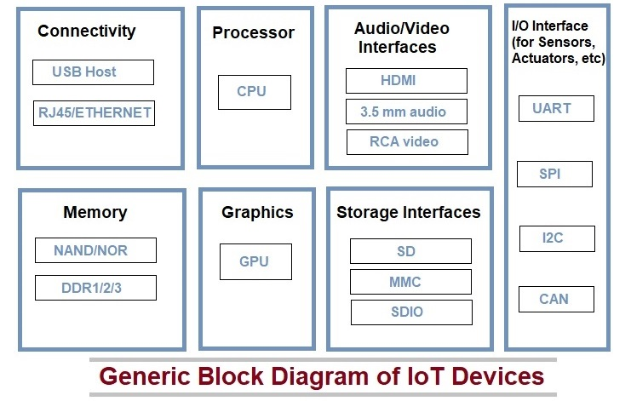
Physical Design of IoT - Things

Slide 28
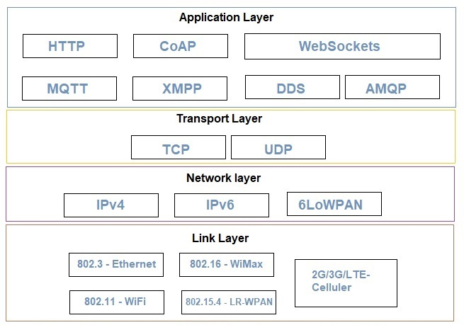
Physical Design of IoT- Protocols
IoT protocols help to establish Communication between IoT Device (Node Device) and Cloud based Server over the Internet.
It helps to send commands to IoT Device and receive data from an IoT device over the Internet.
allows the users to interact with the IoT sensors and access other services provided by the communication network.
provides services like authentication, naming, message formatting, email, etc, to the users.
end-to-end communication between the applications running on hosts. -a logical communication channel
responsible for reliable delivery of the message across the end nodes, flow control and multiplexing and demultiplexing of the channels at end nodes.
Transfer packets from sender to receiver
handles routing
logical addressing (like IP address)
congestion control
Establish and terminate links
handles error detection, retransmission, flow control and access of the link.
defines Format of the packet
Physical addressing

Slide 29
Link Layer Protocols
Link Layer Protocols:The link layer is responsible for establishing and terminating links between the nodes through which packets or datagrams travel
The link layer also handles error detection, retransmission, flow control and access of the link.

Slide 30
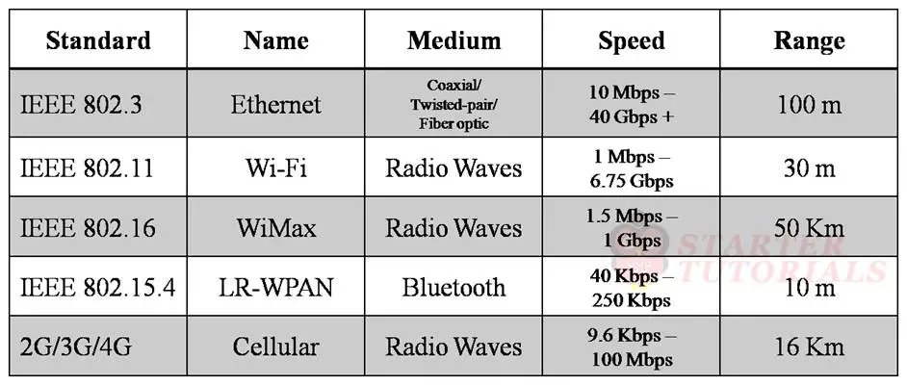
Summary of Link layer protocols

Slide 31
Network Layer Protocols
The main role of the network layer is transfer the packet from sender to receiving host.
The network layer also handles routing, which involves selecting the next node and forwarding the packets across the communication path.
The network layer is also responsible for logical addressing (like IP address) and for congestion control which prevents the network from being overloaded with traffic.

Slide 32
Transport Layer Protocols
The main role of transport layer is providing end-to-end communication between the applications running on hosts.
The transport layer provides a logical communication channel through which the end applications can communicate with each other.
The transport layer is implemented on the end hosts. It is not present in the routers.
The transport layer is also responsible for the reliable delivery of the message across the end nodes, flow control and multiplexing and demultiplexing of the channels at end nodes.

Slide 33
Application Layer Protocols
The application layer allows the users to interact with the IoT sensors and access other services provided by the communication network.
The application layer provides services like authentication, naming, message formatting, email, etc, to the users.

Slide 34
Logical Design of IoT
Logical design of IoT system refers to an abstract representation of the entities & processes without going into the low-level specifies of the implementation.
Logical design of IoT system includes:
IoT Functional Blocks
IoT Communication Models
IoT Communication APIs

Slide 35
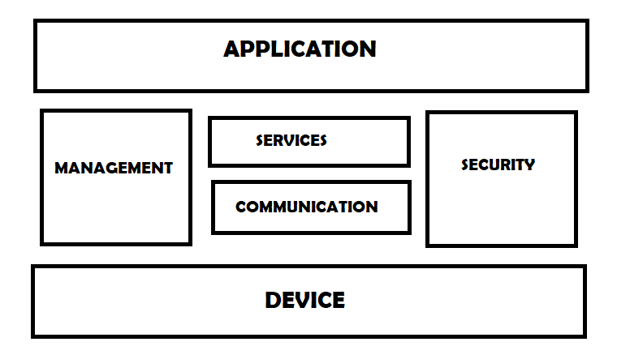
IoT Functional Blocks
overseeing overall operation of IOT system,
device configuration, firmware updates, and system monitoring.
provide analytics and reporting
Interface to control and monitor various aspects of the IoT system.
utilizing the processed data to provide a specified function or service.
authentication , authorization,
data encryption during transmission and storage
intrusion detection and response, assisting in the prevention and mitigation of threats.
sensing,actuation,monitoring and control functions
services for device monitoring, device control , data publishing and device discovery.

Slide 36
IoT Functional Blocks
An IoT system comprises of a number of functional blocks that provide the system the capabilities for identification, sensing, actuation, communication and management.
Device: An IoT system comprises of devices that provide sensing, actuation, monitoring and control functions.
Sensors collect data from their surroundings, whereas actuators drive physical processes. Sensors gather data on temperature, humidity, light, motion, and other variables, whereas actuators turn on lights, open doors, and control machines. These gadgets work together to collect data and operate in the physical world.
Communication: Handles the communication for the IoT system.
Services: services for device monitoring, device control service, data publishing services and services for device discovery.

Slide 37
Management: this blocks provides various functions to govern the IoT system.
The management block is in charge of overseeing the overall operation of the IoT system. This block is capable of handling device configuration, firmware updates, and system monitoring. It can also give analytics and reporting, allowing system administrators to understand how the system is operating and find areas for improvement.
Security: this block secures the IoT system by providing functions such as authentication , authorization, message and content integrity, and data security.
The security block is in charge of assuring the IoT system's security and protection against illegal access. This block is in charge of authentication and authorization, as well as data encryption during transmission and storage. It also handles intrusion detection and response, assisting in the prevention and mitigation of threats.
Application: This is an interface that the users can use to control and monitor various aspects of the IoT system. Application also allow users to view the system status and view or analyze the processed data.
The application block is the component of the IoT system that gives value to the end user. This block is in charge of utilizing the processed data to provide a specified function or service. An application block, for example, could be used to provide insights into energy usage in a building or to adjust the temperature in a greenhouse.

Slide 38
IoT Communication Models: Request-Response Model
Internet of things supports different communication models between the entities in an IoT system.
These communication models are:
Request-Response Model
Publish-Subscribe Model
Push-Pull Model
Exclusive Pair Model

Slide 39
IoT Communication Models: Request-Response Model
Request-response model is communication model in which the client sends requests to the server and the server responds to the requests. When the server receives a request, it decides how to respond, fetches the data, retrieves resource representation, prepares the response, and then sends the response to the client. Request-response is a stateless communication model and each request-response pair is independent of others.
HTTP works as a request-response protocol between a client and server. A web browser may be the client, and an application on a computer that hosts a web site may be the server.
Example: A client (browser) submits an HTTP request to the server; then the server returns a response to the client. The response contains status information about the request and may also contain the requested content.

Slide 40
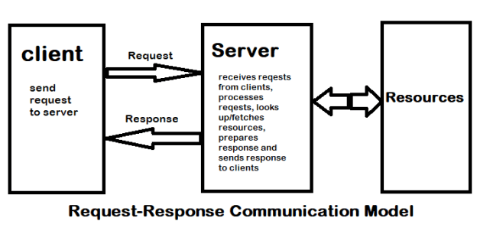
IoT Communication Models: Request-Response Model
Request-response is a stateless communication model and each request-response pair is independent of others.
HTTP works as a request-response protocol between a client and server.
Example:When we search a query on a browser then the browser submits an HTTP request to the server and then the server returns a response to the browser(client).

Slide 41
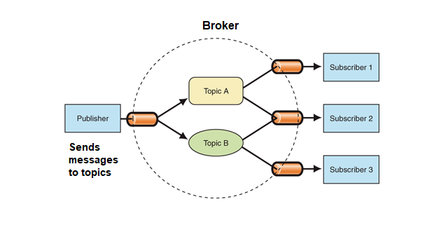
IoT Communication Models: Publish-Subscribe Model
Publishers: Sensors
Broker: Server
Consumers: IOT Applications through which users interact

Slide 42
IoT Communication Models: Publish-Subscribe Model
Publish-Subscribe is a communication model that involves publishers, brokers and consumers. Publishers are the source of data. Publishers send the data to the topics which are managed by the broker. Publishers are not aware of the consumers. Consumers subscribe to the topics which are managed by the broker. When the broker receive data for a topic from the publisher, it sends the data to all the subscribed consumers.

Slide 43
Publish-Subscribe Model
Example
On the website many times we subscribed to their newsletters using our email address. these email addresses are managed by some third-party services and when a new article is published on the website it is directly sent to the broker and then the broker sends these new data or posts to all the subscribers.

Slide 44
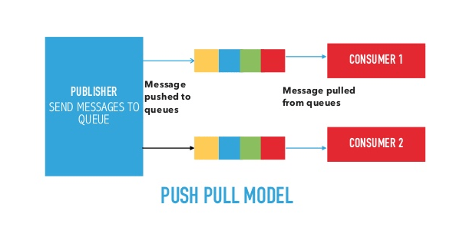
IoT Communication Models: Push-Pull Model
Queues help in decoupling the messaging between the Producers and Consumers.
Queues also act as a buffer which helps whenever there is a mismatch between the rate at which the producers push data and the rate rate at which the consumer pull data.

Slide 45
IoT Communication Models: Push-Pull Model
Push-Pull is a communication model in which the data producers push the data to queues and the consumers Pull the data from the Queues. Producers do not need to be aware of the consumers. Queues help in decoupling the messaging between the Producers and Consumers. Queues also act as a buffer which helps in situations when there is a mismatch between the rate at which the producers push data and the rate rate at which the consumer pull data.

Slide 46
Push Pull Model
Example
When we visit a website we see a number of posts that are published in a queue and according to our requirements, we click on a post and start reading it.

Slide 47
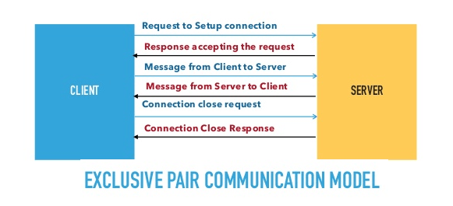
IoT Communication Models: Exclusive Pair Model
Exclusive Pair is a bidirectional, fully duplex communication model that uses a persistent connection between the client and server.
Exclusive pair is stateful communication model and the server is aware of all the open connections.

Slide 48
IoT Communication Models: Exclusive Pair Model
Exclusive Pair is a bidirectional, fully duplex communication model that uses a persistent connection between the client and server.
Connection is set up, it remains open until the client sends a request to close the connection. Client and server can send messages to each other after connection is setup. Exclusive pair is stateful communication model and the server is aware of all the open connections.

Slide 49
IoT Communication APIs
API provides unified interface to access server resources
APIs act as a point of interaction between the IoT devices and the Internet and/or other elements within the network.
In IoT there two types of communication APIs. They are:
REST-based communication APIs
WebSocket-based communication APIs

Slide 50
REST-based communication APIs
REpresentational State Transfer (REST) is a set of architectural principles by which we can design web services and web APIs that focus on system’s resources and how resource states are addressed and transferred.
REST APIs follow request-response model.
REST architectural constraints apply to components, connectors, and data elements within a system.
ex: accuweather.com

Slide 51
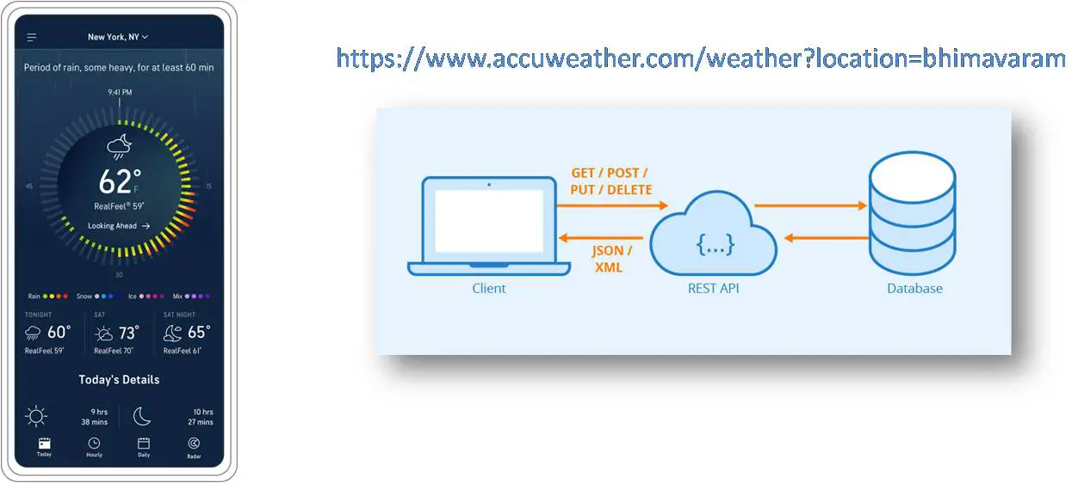
Example: accuweather.com
Accuweather app uses REST API to access weather details

Slide 52
REST architectural constraints
Client-Server: As REST is based on request-response model, the communication involves two entities namely, client and server. A client sends requests and the server process the requests and sends back responses.
Stateless: As REST follows request-response model, it is stateless. The server will not be able to associate a set of requests to a client. It will treat each request as a new request and cannot take advantage of stored context on server. Session state is entirely kept on client.
Cacheable: The response sent by the server might be cached at the client side. This will allow the client to load the response faster next time when it is needed. Improves efficiency.
Layered System: The REST architecture is layered where there is a clear separation in the functionality carried by different entities. e.g Client doesn’t know if it is connected to end server.
Uniform Interface: REST provides an uniform interface for all kinds of applications and devices. Method of communication between client and server should be uniform irrespective of devices or type of application.
Code on Demand: REST enables to access the code based on a specific request. Based on the request, the code that is going to be executed might be changed. Ex Java Servlets, Java Script.

Slide 53
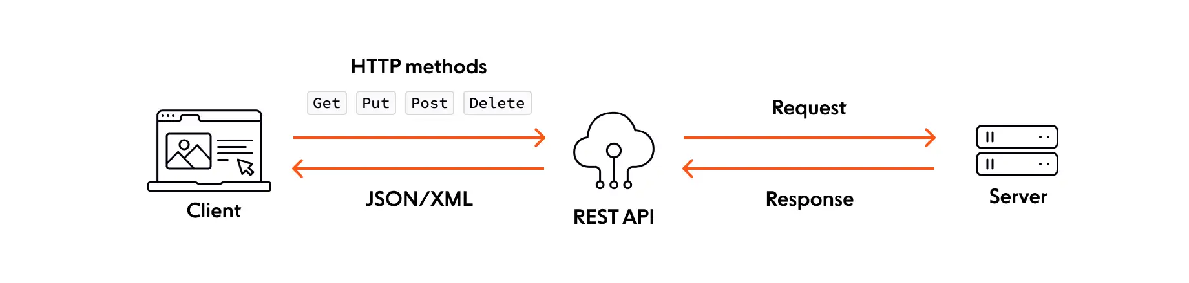
REST API is a middleman for transmitting data between web client and web server .
GET requests to retrieve resources
PUT requests to update resources
PATCH requests to apply partial modifications to resources
POST requests to create resources
DELETE requests to delete resources

Slide 54
Advantages of REST API
Simplicity: REST APIs are relatively simple to design and implement, making them a popular choice for building APIs for web applications
Flexibility: REST APIs can be used to support a wide range of applications and services, from simple web applications to complex enterprise systems.
Caching: REST APIs can leverage caching to improve performance and reduce server load.
Stateless: REST APIs are stateless, meaning that each request is processed independently of any previous requests, making them easy to scale and distribute.

Slide 55
Disadvantages of REST API
Limited real-time support: REST APIs do not support real-time communication between the server and client, making them less suitable for applications that require real-time updates.
Performance overhead: REST APIs require more overhead than WebSocket APIs, as each request and response must contain all the necessary information to complete the request.
Complexity: REST APIs can be complex to design and implement for large, distributed systems.

Slide 56
WebSocket based communication API
WebSocket-based API creates full-duplex communication between clients and servers.
It follows exclusive pair communication model.
WebSocket-based communication is stateful.
No need to establish connection for each request.
It is suitable for IoT applications that have low latency or or high throughput requirements.

Slide 57
WebSocket based communication API
Websocket APIs allow bi-directional, full duplex communication between clients and servers.
Websocket APIs follow the exclusive pair communication model. Unlike request-response model such as REST, the WebSocket APIs allow full duplex communication and do not require new connection to be setup for each message to be sent.
WebSocket communication begins with a connection setup request sent by the client to the server. The request (called websocket handshake) is sent over HTTP and the server interprets it is an upgrade request. If the server supports websocket protocol, the server responds to the websocket handshake response.
After the connection setup client and server can send data/mesages to each other in full duplex mode. Websocket API reduce the network traffic and letency as there is no overhead for connection setup and termination requests for each message. Websocket suitable for IoT applications that have low latency or high throughput requirements. So Web socket is most suitable IoT Communication APIs for IoT System.

Slide 58
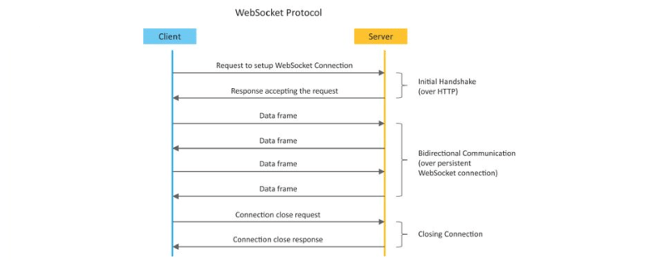

Slide 59
Advantages of Web Socket Based API
Real-time communication: WebSocket APIs enable real-time communication between the server and client, making them ideal for applications that require real-time updates.
Efficiency: WebSocket APIs are more efficient than REST APIs for real-time applications, as they use a persistent connection to enable bidirectional communication.
Scalability: WebSocket APIs are highly scalable, as they can support thousands of connections per server.
Reduced overhead: WebSocket APIs have lower overhead than REST APIs, as they use a single connection to transmit data.

Slide 60
Disadvantages of Websocket Based API
Complexity: WebSocket APIs are more complex to design and implement than REST APIs, requiring additional programming skills and knowledge.
Security: WebSocket APIs can be vulnerable to security threats if not properly secured.
Compatibility: WebSocket APIs are not supported by all browsers, requiring fallback mechanisms for older browsers.

Slide 61
Similarities between REST API and WebSocket API:
Both REST API and WebSocket API are used to build APIs for web applications.
Both REST API and WebSocket API are standardized interfaces that enable communication between the server and client.
Both REST API and WebSocket API can be customized to suit the specific needs of a particular application or system.
Both REST API and WebSocket API can be secured using various authentication and encryption methods.

Slide 62
Differences between REST API and WebSocket API:
S.NO. | REST API | WEB SOCKET API
1. | It is Stateless protocol. It will not store the data. | It is Stateful protocol. It will store the data.
2. | It is Uni-directional. Only either server or client will communicate. | It is Bi-directional. Messages can be received or sent by both server or client.
3. | It is Request-response model. | It is Full duplex(Exclusive pair) model.
4. | New TCP connection will be set up for each HTTP request. | Only Single TCP connection.

Slide 63
Differences between REST API and WebSocket API:
S.NO. | REST API | WEB SOCKET API
5. | Both horizontal and vertical scaling (we can add many resources and number of users both horizontally and vertically). | Only vertical scaling (we can add resources only vertically).
6. | It depends upon the HTTP methods to retrieve the data.. | It depends upon the IP address and port number to retrieve the data
7. | It is slower than web socket regarding the transmission of messages. | web socket transmits messages very fastly than REST API.
8. | It does not need memory or buffers to store the data. | It requires memory and buffers to store the data.

Slide 64
Should I use WebSockets or REST?
Whether you should use a REST architecture or use event-driven WebSockets depends on your use case.
REST API is used for stateless, request/response communication over HTTP, while Web Socket API is used for persistent, bi-directional communication over the WebSocket protocol.
WebSockets are generally ideal for web apps that require real time communication, while REST is tailored for retrieving, creating, and managing resources.

Slide 65
When to use WebSockets
We can broadly group Web Sockets use cases into two distinct categories:
Realtime updates, where the communication is unidirectional, and the server is streaming low-latency (and often frequent) updates to the client.
Examples include live score updates or alerts and notifications
Bidirectional communication, where both the client and the server send and receive messages.
Examples include chat, virtual events, and virtual classrooms (the last two usually involve features like live polls, quizzes, and Q&As).
WebSockets can also be used to underpin multi-user synchronized collaboration functionality, such as multiple people editing the same document simultaneously.

Slide 66
When to use REST
REST is ideal for:
Applications that need to perform actions on resources (e.g. retrieve, update) on an occasional, ad-hoc basis.
Request-driven, non-realtime, and stateless systems.
CRUD operations.
Cloud apps, microservices, and web apps.

Slide 67
Advantages of IoT
Ability to access information from anywhere at any time on any device;
Improved communication between connected electronic devices;
Transferring data packets over a connected network saving time and money; and
Automating tasks helping to improve the quality of a business's services and reducing the need for human intervention.

Slide 68
Disadvantages IoT
As the number of connected devices increases and more information is shared between devices, the potential that a hacker could steal confidential information also increases.
Enterprises may eventually have to deal with massive numbers -- maybe even millions -- of IoT devices, and collecting and managing the data from all those devices will be challenging.
If there's a bug in the system, it's likely that every connected device will become corrupted.
Since there's no international standard of compatibility for IoT, it's difficult for devices from different manufacturers to communicate with each other.

Slide 69
Why Is Internet of Things (IoT) so important?
Over the past few years, IoT has become one of the most important technologies of the 21st century.
Now that we can connect everyday objects—kitchen appliances, cars, thermostats, baby monitors—to the internet via embedded devices, seamless communication is possible between people, processes, and things.
By means of low-cost computing, the cloud, big data, analytics, and mobile technologies, physical things can share and collect data with minimal human intervention.

Slide 70
IoT Applications
Agriculture:
Indoor Planting: Monitoring and management of micro-climate conditions.
Outdoor planting: soil moisture and nutrients sensing in conjunction with weather data and smart irrigation and fertilizer, sprinkler systems.
-Optimize planting process , irrigation levels required ,fertilizer amount etc..

Slide 71
IoT Applications
2. Healthcare:
Wearable IoT devices :Monitor patients health at home
Smart beds: keep the staff informed about availability.
IoT sensors on critical equipments
Elderly care
Surgical Robots: high precision and control,
Disinfectants robots: uses high intensity UV light,
Nursing robots

Slide 72
IoT Applications
3. Manufacturing
RFID and GPS technology can help manufacturer:
product tracking( whole SC from start to end),
gather information on travel time
product condition and
environment conditions that the product is subjected to.
Sensors attached to factory equipment can
Identify bottlenecks in production line
track performance of machine,
predict when maintenance is required.

Slide 73
IoT Applications
4. Smart Home:
Connect all home appliances into a single system and control each with smartphone.

Slide 74
IoT Applications
5. Smart Vehicles:
Self driving cars: Features include
sensors that handle navigation, various antennas,control speeding and slowing down etc.
Here IOT is critical as cars needs to be extremely accurate.

Slide 75
IoT Applications
6. Smart Cities: fewer resources , more energy efficient
Includes combination of Sensors for
managing the traffic,
handling waste management,
optimizing streetlights,
saving water,
monitoring energy expenditure,
crating smart buildings,
and many more tasks.

Slide 76
IoT Applications
7. Smart Wearables:
Smart wearables serve a wide range of purposes from a medical to fitness to GPS tracking.
Fitness bands, heart rate monitors and smartwatches
Virtual glasses and GPS tracking belts
Guardian glucose monitoring device

Slide 77
IoT Applications
8. Smart Retail:
Handle inventory,
improve store operations,
reduce shoplifting and theft, and
prevent long queues at cashiers
Ex: Amazon Go stores provide IoT enabled shopping experience

Slide 78
Challenges of Internet of Things (IoT)
Insufficient testing and updating
Concern regarding data security and privacy
Software complexity
Data volumes and interpretation
Integration with AI and automation
Devices require a constant power supply which is difficult
Interaction and short-range communication

Slide 79
Security challenges in IoT
1. Lack of encryption – Although encryption is a great way to prevent hackers from accessing data, it is also one of the leading IoT security challenges. These drives like the storage and processing capabilities that would be found on a traditional computer. The result is an increase in attacks where hackers can easily manipulate the algorithms that were designed for protection.
2. Insufficient testing and updating – With the increase in the number of IoT(internet of things) devices, IoT manufacturers are more eager to produce and deliver their device as fast as they can without giving security too much of although. Most of these devices and IoT products do not get enough testing and updates and are prone to hackers and other security issues.

Slide 80
Security challenges in IoT
3. Brute forcing and the risk of default passwords – Weak credentials and login details leave nearly all IoT devices vulnerable to password hacking and brute force. Any company that uses factory default credentials on their devices is placing both their business and its assets and the customer and their valuable information at risk of being susceptible to a brute force attack.
4. IoT Malware and ransomware – Increases with increase in devices. Ransomware uses encryption to effectively lock out users from various devices and platforms and still use a user’s valuable data and info. Example – A hacker can hijack a computer camera and take pictures. By using malware access points, the hackers can demand ransom to unlock the device and return the data.

Slide 81
Security challenges in IoT
5. IoT botnet aiming at cryptocurrency – IoT botnet workers can manipulate data privacy, which could be massive risks for an open Crypto market. The exact value and creation of cryptocurrencies code face danger from mal-intentioned hackers. The blockchain companies are trying to boost security. Blockchain technology itself is not particularly vulnerable, but the app development process is.
6. Inadequate device security : Inadequate device security refers to the lack of proper measures to protect electronic devices such as computers, smartphones, and IoT devices from cyber attacks, hacking, data theft, and unauthorized access. This can happen due to outdated software, weak passwords, unpatched vulnerabilities, lack of encryption, and other security risks. It is important to regularly update the software and implement strong security measures to ensure the security and privacy of sensitive information stored on these devices. Many IoT devices have weak security features and can be easily hacked.

Slide 82
Security Challenges of Internet of Things (IoT)
7. Lack of standardization: Lack of standardization refers to the absence of agreed-upon specifications or protocols in a particular field or industry. This can result in different systems, products, or processes being incompatible with each other, leading to confusion, inefficiency, and decreased interoperability. For example, in the context of technology, a lack of standardization can cause difficulties in communication and data exchange between different devices and systems. Establishing standards and protocols can help overcome this and ensure uniformity and compatibility. There is a lack of standardization in IoT devices, making it difficult to secure them consistently.
8. Vulnerability to network attacks: Vulnerability to network attacks refers to the susceptibility of a network, system or device to being compromised or exploited by cyber criminals. This can happen due to weaknesses in the network infrastructure, unpatched software, poor password management, or a lack of appropriate security measures. Network attacks can result in data theft, loss of privacy, disruption of services, and financial loss. To reduce vulnerability to network attacks, it’s important to implement strong security measures such as firewalls, encryption, and regular software updates, as well as educate users on safe internet practices. IoT devices rely on networks, making them vulnerable to attacks like denial-of-service (DoS) attacks.

Slide 83
Security challenges in IoT
9. Unsecured data transmission: Unsecured data transmission refers to the transfer of data over a network or the internet without adequate protection. This can leave the data vulnerable to interception, tampering, or theft by malicious actors. Unsecured data transmission can occur when data is transmitted over an unencrypted network connection or when insecure protocols are used. To protect sensitive data during transmission, it is important to use secure protocols such as SSL/TLS or VPN, and to encrypt the data before sending it. This can help to ensure the confidentiality and integrity of the data, even if it is intercepted during transmission. IoT devices often transmit sensitive data, which may be vulnerable to eavesdropping or tampering if not properly secured.
10. Privacy concerns: Privacy concerns refer to issues related to the collection, storage, use, and sharing of personal information. This can include concerns about who has access to personal information, how it is being used, and whether it is being protected from unauthorized access or misuse. In the digital age, privacy concerns have become increasingly important as personal information is being collected and stored on an unprecedented scale. To address privacy concerns, individuals and organizations need to implement appropriate security measures to protect personal information, be transparent about how it is being used, and respect individuals’ rights to control their own information. Additionally, privacy laws and regulations have been established to provide guidelines and protections for individuals’ personal information. The vast amount of data generated by IoT devices raises privacy concerns, as personal information could be collected and used without consent.

Slide 84
Security challenges in IoT
11. Software vulnerabilities: Software vulnerabilities are weaknesses or flaws in software code that can be exploited by attackers to gain unauthorized access, steal sensitive information, or carry out malicious activities. Software vulnerabilities can arise from errors or mistakes made during the development process, or from the use of outdated or unsupported software. Attackers can exploit these vulnerabilities to gain control over a system, install malware, or steal sensitive information. To reduce the risk of software vulnerabilities, it is important for software developers to follow secure coding practices and for users to keep their software up-to-date and properly configured. Additionally, organizations and individuals should implement robust security measures, such as firewalls, antivirus software, and intrusion detection systems, to protect against potential threats. IoT devices often have software vulnerabilities, which can be exploited by attackers to gain access to devices and networks.

Slide 85
Challenges of Internet of Things (IoT) Security challenges in IoT
12. Insider threats: Insider threats refer to security risks that come from within an organization, rather than from external sources such as hackers or cyber criminals. These threats can take many forms, such as employees who intentionally or unintentionally cause harm to the organization, contractors who misuse their access privileges, or insiders who are coerced into compromising the security of the organization. Insider threats can result in data breaches, theft of intellectual property, and damage to the reputation of the organization. To mitigate the risk of insider threats, organizations should implement strict access controls, monitor employee activity, and provide regular training on security and privacy policies. Additionally, organizations should have a plan in place to detect, respond to, and recover from security incidents involving insiders. Employees or contractors with access to IoT systems can pose a security risk if they intentionally or unintentionally cause harm.
To address these challenges, it is important to implement security measures such as encryption, secure authentication, and software updates to ensure the safe and secure operation of IoT devices and systems.

Slide 86
Challenges of Internet of Things (IoT) Design challenges in IoT
Design challenges in IoT (Internet of Things) refer to the technical difficulties and trade-offs involved in creating connected devices that are both functional and secure. Some of the key design challenges in IoT include:
1. Interoperability: Interoperability refers to the ability of different systems, devices, or components to work together seamlessly and exchange data effectively. In the context of the Internet of Things (IoT), interoperability is a critical challenge, as a large number of diverse devices are being connected to the internet. The lack of standardization in the IoT can lead to difficulties in communication and data exchange between devices, resulting in an fragmented and inefficient system. To overcome this challenge, organizations and industry groups are working to establish standards and protocols to ensure interoperability between IoT devices. This includes the development of common communication protocols, data formats, and security standards. Interoperability is important for enabling the full potential of the IoT and allowing connected devices to work together effectively and efficiently. Ensuring that different IoT devices can work together seamlessly and exchange data effectively.

Slide 87
Design challenges in IoT
2. Security: Security is a critical concern in the Internet of Things (IoT) as it involves the protection of sensitive data and systems from unauthorized access, theft, or damage. IoT devices are often vulnerable to cyber attacks due to their increased exposure to the internet and their limited computing resources. Some of the security challenges in IoT include:
Device security: Ensuring that IoT devices are protected from malware and unauthorized access.
Network security: Protecting the communication between IoT devices and the network from cyber attacks.
Data security: Securing the data collected and transmitted by IoT devices from unauthorized access or tampering.
Privacy: Protecting the privacy of individuals whose personal information is collected and transmitted by IoT devices. To address these security challenges, organizations should implement robust security measures such as encryption, firewalls, and regular software updates. Additionally, they should conduct regular security audits and assessments to identify and address potential security risks. By prioritizing security, organizations can help to protect the sensitive data and systems involved in IoT and reduce the risk of cyber attacks.Protecting IoT devices and the sensitive data they collect and transmit from cyber threats and unauthorized access.

Slide 88
Design challenges in IoT
3. Scalability: Scalability refers to the ability of a system to handle increasing workloads or numbers of users without a significant decline in performance. In the context of the Internet of Things (IoT), scalability is a major challenge as the number of connected devices is rapidly growing, leading to an increased volume of data and communication. Scalability challenges in IoT include:
Data management: Effectively managing and storing the large amounts of data generated by IoT devices.
Network capacity: Ensuring that networks have sufficient capacity to handle the increased volume of data and communication.
Device management: Efficiently managing the growing number of IoT devices and ensuring that they can be easily configured and maintained.
To address these scalability challenges, organizations should adopt scalable architectures, such as cloud computing, that can accommodate the growing number of IoT devices and the data they generate. Additionally, they should implement efficient data management and storage solutions, such as distributed databases and data lakes, to handle the increased volume of data. By prioritizing scalability, organizations can ensure that their IoT systems can handle the growing number of connected devices and continue to deliver high performance and efficiency. Designing systems that can accommodate large numbers of connected devices and manage the resulting data flow effectively.

Slide 89
Design challenges in IoT
4. Reliability: Reliability refers to the ability of a system to perform its intended function consistently and without failure over time. In the context of the Internet of Things (IoT), reliability is a critical concern, as the failure of even a single IoT device can have significant consequences. Some of the reliability challenges in IoT include:
Device failure: Ensuring that IoT devices are designed and built to be reliable and function correctly even in harsh environments.
Network connectivity: Maintaining stable and reliable connections between IoT devices and the network, even in the face of hardware or software failures.
Data accuracy: Ensuring that the data collected and transmitted by IoT devices is accurate and reliable.
To address these reliability challenges, organizations should implement robust and reliable hardware and software designs for IoT devices, and conduct regular testing and maintenance to identify and resolve any issues. They should also implement redundant systems and failover mechanisms to ensure that the system continues to function in the event of a failure. By prioritizing reliability, organizations can help ensure that their IoT systems perform consistently and without failure, delivering the intended benefits and results. Ensuring that IoT systems remain functional and accessible even in the face of hardware or software failures.

Slide 90
Design challenges in IoT
5. Power consumption: Power consumption refers to the amount of energy that a system or device uses. In the context of the Internet of Things (IoT), power consumption is a critical challenge, as many IoT devices are designed to be small, low-power, and operate using batteries. Some of the power consumption challenges in IoT include:
Battery life: Ensuring that IoT devices have sufficient battery life to operate without frequent recharging or replacement.
Energy efficiency: Making sure that IoT devices are designed to use energy efficiently and reduce the overall power consumption of the system.
Power management: Implementing effective power management techniques, such as sleep modes, to reduce the power consumption of IoT devices when they are not in use.
To address these power consumption challenges, organizations should adopt low-power technologies and energy-efficient designs for IoT devices. They should also implement effective power management techniques, such as sleep modes, to reduce the power consumption of IoT devices when they are not in use. By prioritizing power consumption, organizations can help ensure that their IoT systems are energy efficient, reducing costs and environmental impact. Minimizing the power consumption of IoT devices to extend battery life and reduce costs.

Slide 91
Design challenges in IoT
6. Privacy: Privacy is a critical concern in the Internet of Things (IoT), as IoT devices collect, store, and transmit large amounts of personal and sensitive information. Some of the privacy challenges in IoT include:
Data collection: Ensuring that only the necessary data is collected and that it is collected in a way that respects individuals’ privacy rights.
Data storage: Ensuring that the data collected by IoT devices is stored securely and that access to it is strictly controlled.
Data sharing: Controlling who has access to the data collected by IoT devices and ensuring that it is not shared without proper authorization.
To address these privacy challenges, organizations should implement robust privacy policies and procedures, such as data protection, data minimization, and data retention. They should also educate users on the privacy implications of using IoT devices and encourage them to take steps to protect their privacy. Additionally, organizations should adopt privacy-enhancing technologies, such as encryption and anonymization, to protect the privacy of individuals whose information is collected by IoT devices. By prioritizing privacy, organizations can help to ensure that individuals’ rights and freedoms are respected, and that sensitive information is protected from unauthorized access or misuse. Protecting the privacy of individuals whose personal information is collected and transmitted by IoT devices.

Slide 92
Design challenges in IoT
7. Battery life is a limitation – Issues in packaging and integration of small-sized chip with low weight and less power consumption. If you’ve been following the mobile space, you’ve likely see how every yr it looks like there’s no restriction in terms of display screen size. Take the upward thrust of ‘phablets’, for instance, which can be telephones nearly as huge as tablets. Although helpful, the bigger monitors aren’t always only for convenience, rather, instead, display screen sizes are growing to accommodate larger batteries. Computers have getting slimmer, but battery energy stays the same.
8. Increased cost and time to market – Embedded systems are lightly constrained by cost. The need originates to drive better approaches when designing the IoT devices in order to handle the cost modelling or cost optimally with digital electronic components. Designers also need to solve the design time problem and bring the embedded device at the right time to the market.
9. Security of the system – Systems have to be designed and implemented to be robust and reliable and have to be secure with cryptographic algorithms and security procedures. It involves different approaches to secure all the components of embedded systems from prototype to deployment.
Designers and engineers must carefully balance these design challenges to create IoT systems that are functional, secure, and scalable.

Slide 93
Deployment challenges in IoT
The deployment of Internet of Things (IoT) systems can present several challenges, including:
Connectivity – It is the foremost concern while connecting devices, applications and cloud platforms. Connected devices that provide useful front and information are extremely valuable. But poor connectivity becomes a challenge where IoT sensors are required to monitor process data and supply information.
Cross platform capability – IoT applications must be developed, keeping in mind the technological changes of the future. Its development requires a balance of hardware and software functions. It is a challenge for IoT application developers to ensure that the device and IoT platform drivers the best performance despite heavy device rates and fixings.
Data collection and processing – In IoT development, data plays an important role. What is more critical here is the processing or usefulness of stored data. Along with security and privacy, development teams need to ensure that they plan well for the way data is collected, stored or processed within an environment.

Slide 94
Design challenges in IoT
4.Lack of skill set – All of the development challenges above can only be handled if there is a proper skilled resource working on the IoT application development. The right talent will always get you past the major challenges and will be an important IoT application development asset.
5. Integration: Ensuring that IoT devices and systems integrate seamlessly with existing technology and infrastructure.
6. Network infrastructure: Building and maintaining the network infrastructure needed to support the large number of connected IoT devices.
7. Device management: Efficiently managing and maintaining the large number of IoT devices in a deployment.
8. Data management: Managing and analyzing the large amounts of data generated by IoT devices, and integrating it with existing data systems.
9. Security: Ensuring that the IoT deployment is secure from threats such as cyber attacks, data breaches, and unauthorized access.
10. Cost: Balancing the cost of deploying and maintaining an IoT system with the benefits it delivers.

Slide 95
Deployment challenges in IoT
To address these deployment challenges, organizations should adopt a structured and well-planned deployment approach, involving the careful selection of hardware and software components, careful planning of the network infrastructure, and the development of a robust security strategy. They should also implement efficient device and data management systems, and seek to maximize the return on investment by choosing cost-effective solutions. By approaching deployment in a structured and well-planned manner, organizations can help ensure that their IoT systems deliver the intended benefits and results.

Slide 96
IoT Levels & Deployment Templates
Database: Database can be either local or in the cloud and stores the data generated by the IoT device.
Web Service: Web services serve as a link between the IoT device, application, database and analysis components. Web service can be either implemented using HTTP and REST principles (REST service) or using WebSocket protocol (WebSocket service).
Analysis Component: The Analysis Component is responsible for analyzing the IoT data and generate results in a form which are easy for the user to understand.
Application: IoT applications provide an interface that the users can use to control and monitor various aspects of the IoT system. Applications also allow users to view the system status and view the processed data.
Book website: http://www.internet-of-things-book.com

Slide 97
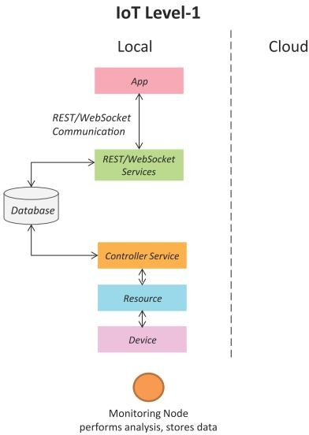
IoT Level-1 (Ex: Home automation system)
A level-1 IoT system has a single node/device that performs sensing and/or actuation, stores data, performs analysis and hosts the application
Level-1 IoT systems are suitable for modeling low- cost and low-complexity solutions where the data involved is not big and the analysis requirements are not computationally intensive.
UI
Book website: http://www.internet-of-things-book.com

Slide 98
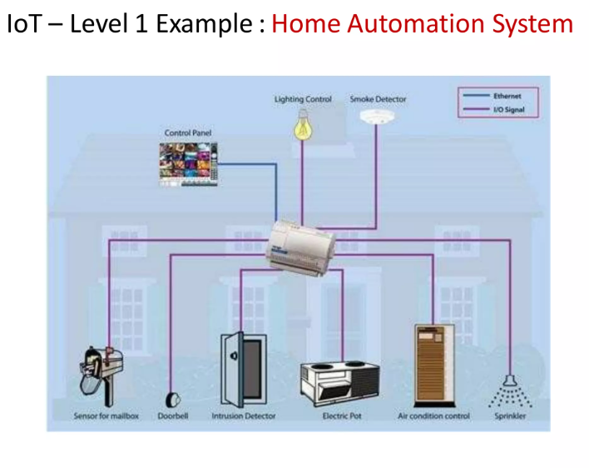

Slide 99
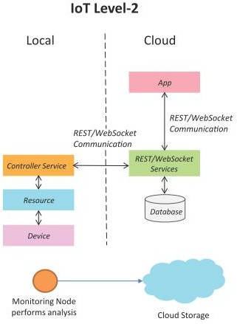
IoT Level-2 (Ex:Smart Irrigation System)
A level-2 IoT system has a single node that performs sensing and/or actuation and local analysis.
Data is stored in the cloud and application is usually cloud- based.
Level-2 IoT systems are suitable for solutions where the data involved is big, however, the primary analysis requirement is not computationally intensive and can be done locally itself.
Book website: http://www.internet-of-things-book.com

Slide 100
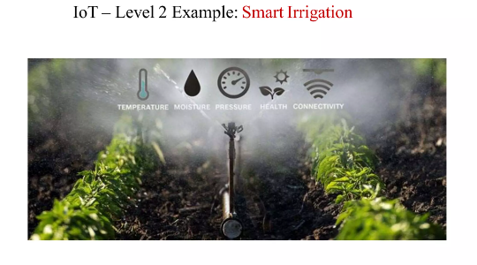

Slide 101
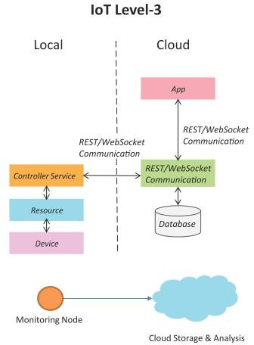
IoT Level-3 (System for tracking package handling)
A level-3 IoT system has a single node. Data is stored and analyzed in the cloud and application is cloud- based.
Level-3 IoT systems are suitable for solutions where the data involved is big and the analysis requirements are computationally intensive.
Book website: http://www.internet-of-things-book.com

Slide 102
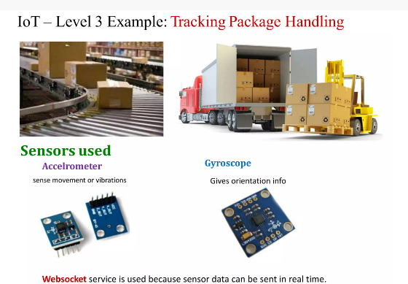

Slide 103
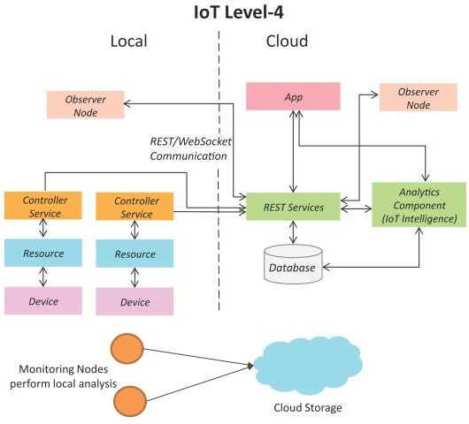
IoT Level-4 (Ex: System for noise monitoring)
A level-4 IoT system has multiple nodes that perform local analysis. Data is stored in the cloud and application is cloud-based.
Level-4 contains local and cloud- based observer nodes which can subscribe to and receive information collected in the cloud from IoT devices.
–Observer nodes do not perform any control functions.
Level-4 IoT systems are suitable for solutions where multiple nodes are required, the data involved is big and the analysis requirements are computationally intensive.
Book website: http://www.internet-of-things-book.com

Slide 104
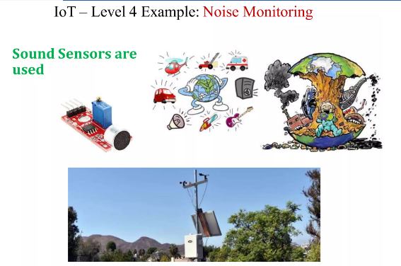

Slide 105
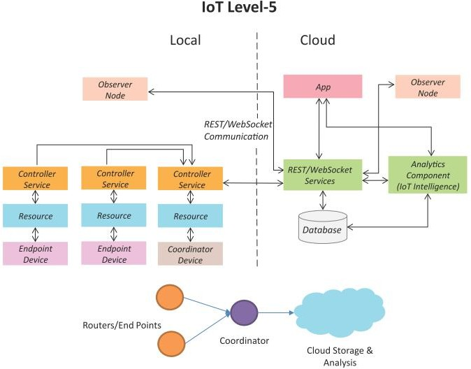
IoT Level-5 (Ex: System for forest fire detection)
A level-5 IoT system has multiple end nodes and one coordinator node.
The end nodes perform sensing and/or actuation.
Coordinator node collects data from the end nodes and sends to the cloud.
Data is stored and analyzed in the cloud and application is cloud-based.
Level-5 IoT systems are suitable for solutions based on wireless sensor networks, in which the data involved is big and the analysis requirements are computationally intensive.
Book website: http://www.internet-of-things-book.com

Slide 106
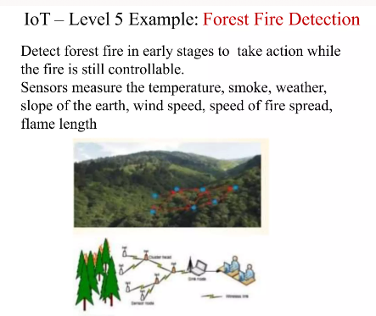

Slide 107
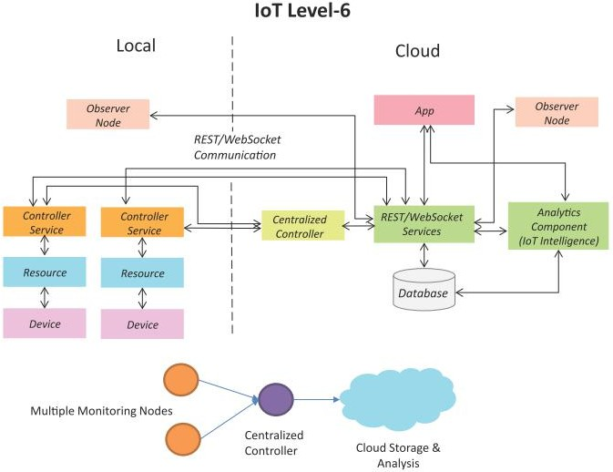
IoT Level-6: Weather monitoring system
A level-6 IoT system has multiple independent end nodes that perform sensing and/or actuation and send data to the cloud.
Data is stored in the cloud and application is cloud-based.
The analytics component analyzes the data and stores the results in the cloud database.
The results are visualized with the cloud-based application.
The centralized controller is aware of the status of all the end nodes and sends control commands to the nodes.
Book website: http://www.internet-of-things-book.com

Slide 108
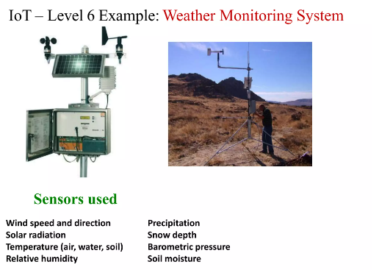

Slide 109
IOT: Conceptual View
The main tasks of this framework are to analyze and determine the smart activities of these intelligent devices through maintaining a dynamic interconnection among those devices. The proposed framework will help to standardize IoT infrastructure so that it can receive e-services based on context information leaving the current infrastructure unchanged. The active collaboration of these heterogeneous devices and protocols can lead to future ambient computing where the maximum utilization of cloud computing will be ensured.
This model is capable of logical division of physical devices placement, creation of virtual links among different domains, networks and collaborate among multiple application without any central coordination system. IaaS can afford standard functionalities to accommodate and provides access to cloud infrastructure. The service is generally offered by modern data centers maintained by giant companies and organization. It is categorized as virtualization of resources which permits a user to install and run application over virtualization layer and allows the system to be distributed, configurable and scalable.
Total infrastructure system can be categorized into 4 layers to receive context supported e-services out of raw data from the Internet of Things. These 4 layers establish a generic framework that does not alter the current network infrastructure but create an interfacing among services and entities through network virtualization.

Slide 110
